Slide 1

My Linear Relationships Interactive Notebook
Name
Class
Term 3 Semester 2

Slide 2
Contents
Formula Page
Page
Date
Description
2
3

Slide 3
Tasks
24
7
30
Essential Question
Questions
Notes
Summary
12
13

Slide 4
24
7
30
Date
Gradient
EQ – Describe how the gradient is calculated?
13

Slide 5
24
7
30
Date
Gradient
EQ – Describe how the gradient is calculated?
The gradient is the number that describes the steepness of a line
13

Slide 6
Geogebra Gradient demo

Slide 7
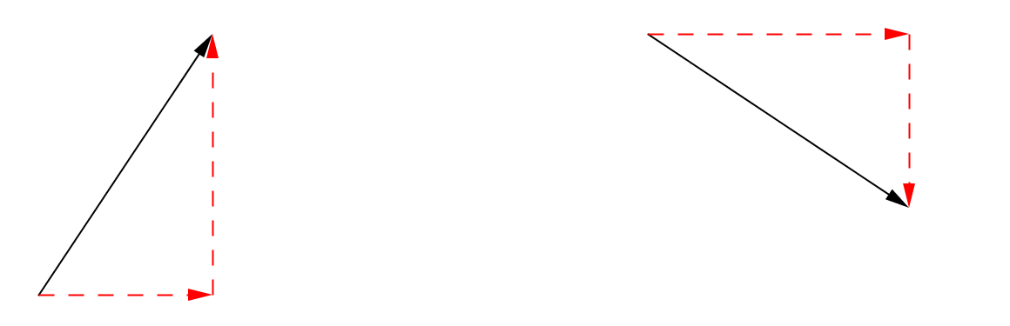
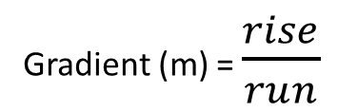
24
7
30
Date
Gradient
EQ – Describe how the gradient is calculated?
The gradient is the number that describes the steepness of a line.
Gradient (m) = $\frac{rise}{run}$
13

Slide 8
24
7
30
Date
Gradient
EQ – Describe how the gradient is calculated?
The gradient is the number that describes the steepness of a line.
Gradient (m) = $\frac{rise}{run}$
Positive
Gradient
13

Slide 9
24
7
30
Date
Gradient
EQ – Describe how the gradient is calculated?
The gradient is the number that describes the steepness of a line.
Gradient (m) = $\frac{rise}{run}$
Positive
Gradient
Negative
Gradient
13

Slide 10
24
7
30
Date
Gradient
EQ – Describe how the gradient is calculated?
The gradient is the number that describes the steepness of a line.
Gradient (m) = $\frac{rise}{run}$
Positive
Gradient
Rise
+ive
Negative
Gradient
Run
13

Slide 11
24
7
30
Date
Gradient
EQ – Describe how the gradient is calculated?
The gradient is the number that describes the steepness of a line.
Gradient (m) = $\frac{rise}{run}$
Run
Positive
Gradient
Rise
- ive
Rise
+ive
Negative
Gradient
Always go left to right
Run
13

Slide 12
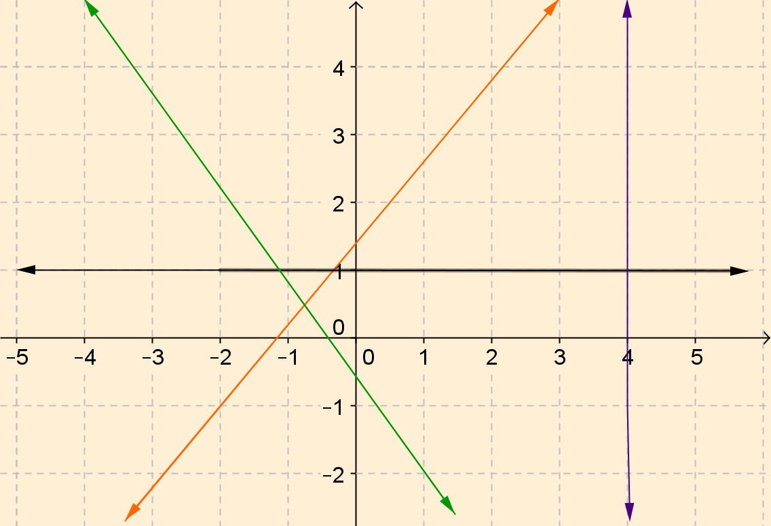
24
7
30
Date
Gradient
EQ – Describe how the gradient is calculated?
13

Slide 13
24
7
30
Date
Gradient
EQ – Describe how the gradient is calculated?
Positive
13

Slide 14
24
7
30
Date
Gradient
EQ – Describe how the gradient is calculated?
Negative
Positive
13

Slide 15
24
7
30
Date
Gradient
EQ – Describe how the gradient is calculated?
Negative
Positive
13

Slide 16
24
7
30
Date
Gradient
EQ – Describe how the gradient is calculated?
Negative
Positive
Zero
13

Slide 17
24
7
30
Date
Gradient
EQ – Describe how the gradient is calculated?
undefined
Negative
Positive
Zero
13

Slide 18
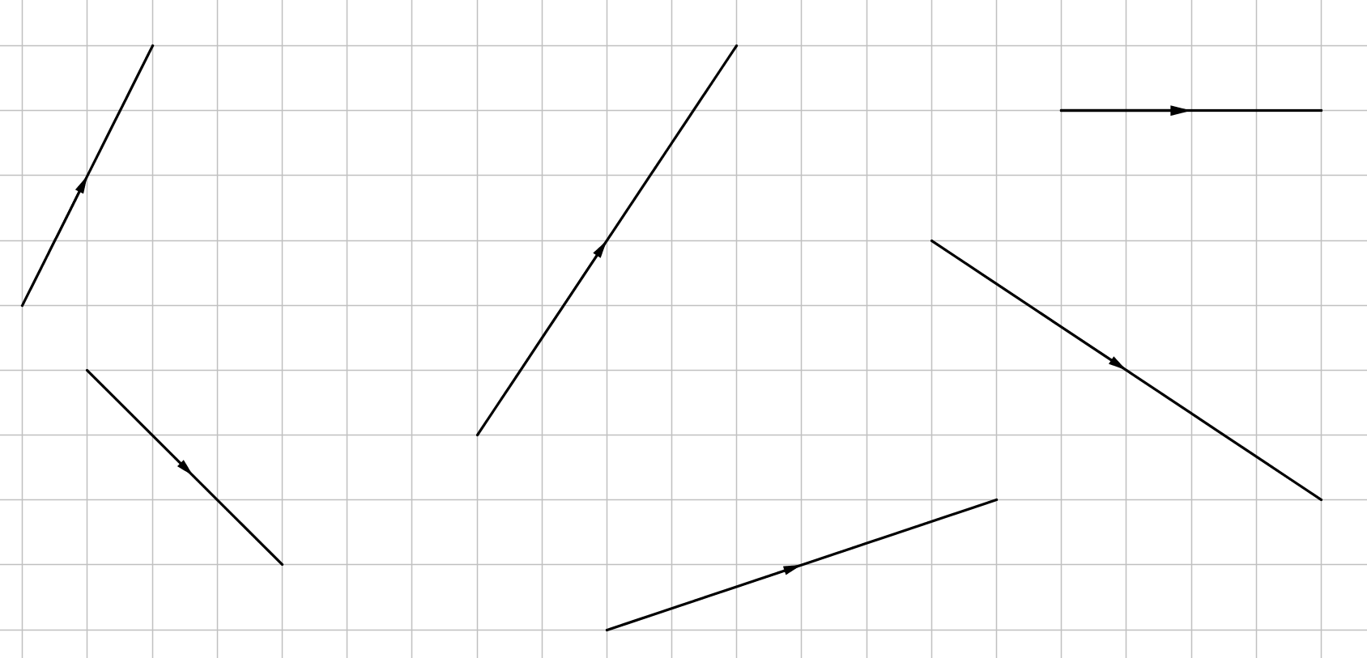
Task – Find the Gradient

Slide 19
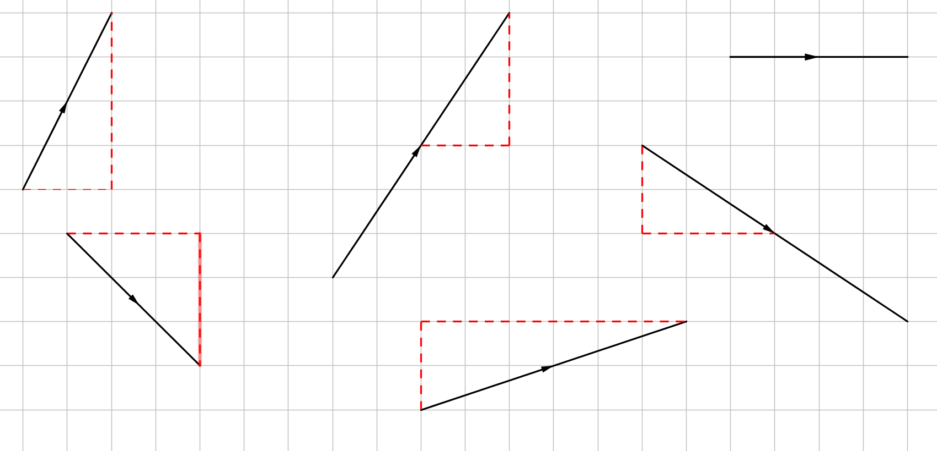
Task – Find the Gradient
4
2

Slide 20
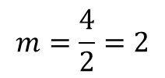
Task – Find the Gradient
$$m=\frac{4}{2}=2$$
4
2

Slide 21
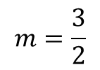
Task – Find the Gradient
$$m=\frac{4}{2}=2$$
3
4
2
2
$$m=\frac{3}{2}$$

Slide 22
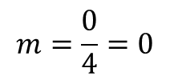
Task – Find the Gradient
$$m=\frac{4}{2}=2$$
3
$$m=\frac{0}{4}=0$$
4
2
2
$$m=\frac{3}{2}$$

Slide 23
Task – Find the Gradient
$$m=\frac{4}{2}=2$$
3
$$m=\frac{0}{4}=0$$
4
2
2
$$m=\frac{3}{2}$$
3
-3

Slide 24
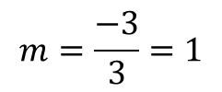
Task – Find the Gradient
$$m=\frac{4}{2}=2$$
3
$$m=\frac{0}{4}=0$$
4
2
2
$$m=\frac{3}{2}$$
3
-3
$$m=\frac{−3}{3}=1$$

Slide 25
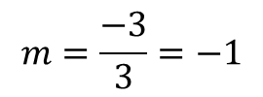
Task – Find the Gradient
$$m=\frac{4}{2}=2$$
3
$$m=\frac{0}{4}=0$$
4
2
2
$$m=\frac{3}{2}$$
3
-3
6
$$m=\frac{−3}{3}=−1$$
2

Slide 26
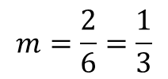
Task – Find the Gradient
$$m=\frac{4}{2}=2$$
3
$$m=\frac{0}{4}=0$$
4
2
2
$$m=\frac{3}{2}$$
3
-3
6
$$m=\frac{−3}{3}=−1$$
2
$$m=\frac{2}{6}=\frac{1}{3}$$

Slide 27
Task – Find the Gradient
$$m=\frac{4}{2}=2$$
3
$$m=\frac{0}{4}=0$$
4
2
2
$$m=\frac{3}{2}$$
-2
3
3
-3
6
$$m=\frac{−3}{3}=−1$$
2
$$m=\frac{2}{6}=\frac{1}{3}$$

Slide 28
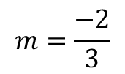
Task – Find the Gradient
$$m=\frac{4}{2}=2$$
3
$$m=\frac{0}{4}=0$$
4
2
$$m=\frac{3}{2}$$
-2
$$m=\frac{−2}{3}$$
2
3
3
-3
6
$$m=\frac{−3}{3}=−1$$
2
$$m=\frac{2}{6}=\frac{1}{3}$$

Slide 29
24
7
30
Date
Gradient
EQ – Describe how the gradient is calculated?
13

Slide 30
Questions

Slide 31
Notes Review
24, 7 ,30
Date
Title
Essential question
Notes complete
Notes complete with colour and diagrams
Questions completed
Contents page filed in
Formula page filled in

Slide 32
Homework
Review your notes and write a summary answering the essential question.

